Slide 1
Computer Vision & Autonomous Car
Supervised By:
Mr. Md. Wasi Ul Kabir
Assistant Professor, Dept. of CSE,
Ahsanullah University of Science and Technology
Presented By:
Swopnil Dewan 14.01.04.006
Alauddin al azad 14.01.04.067
Nafis islam 14.02.04.014
Hafizul islam himel 14.02.04.024

Slide 2
Problem Description
A Study on Traffic Lights and Car Brake-Light Detection and Classification
For Autonomous Car

Slide 3
Problem Solution Pipeline
Detect
Classify
Classify
Track
Image
Traffic Light Position

Slide 4
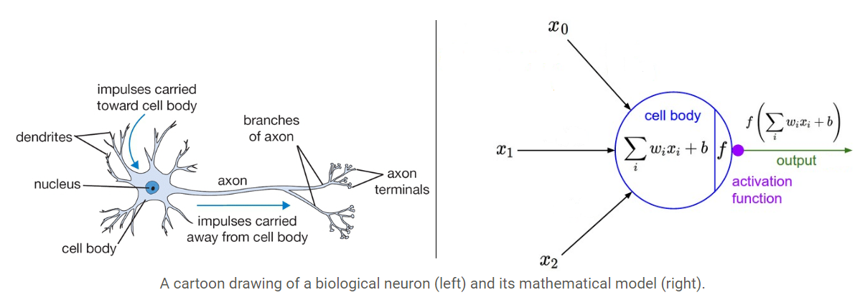
Intro To Artificial Neural Network

Slide 5

Deep Neural Network

Slide 6
DNN Training Pipeline
Forward Propagation
Adaptive System
( W, b )
Prediction,
Input , x
Desired, y
Update system
Training algorithm
Error
Backward Propagation

Slide 7
Our Classification Pipeline
Traffic light train dataset image
True class of each image of train dataset
Training
Pre-processing
Deep neural network classifier
Testing
Traffic light test image dataset
Pre-processing
Trained Deep Neural Network classifier
Predicted class of each image

Slide 8
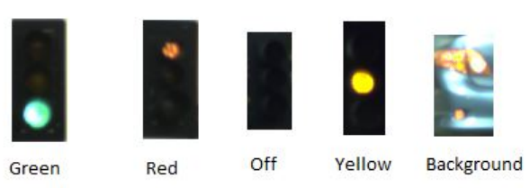
Dataset Analysis
Bosche Traffic Light Dataset : 5093 training and 8334 testing images.
Cropped traffic light images from dataset.
Added random background images.
Created training set of 12503 containing 10698 traffic light and 1805 background images.
Test set contains 13486 images of traffic lights, no background images.

Slide 9
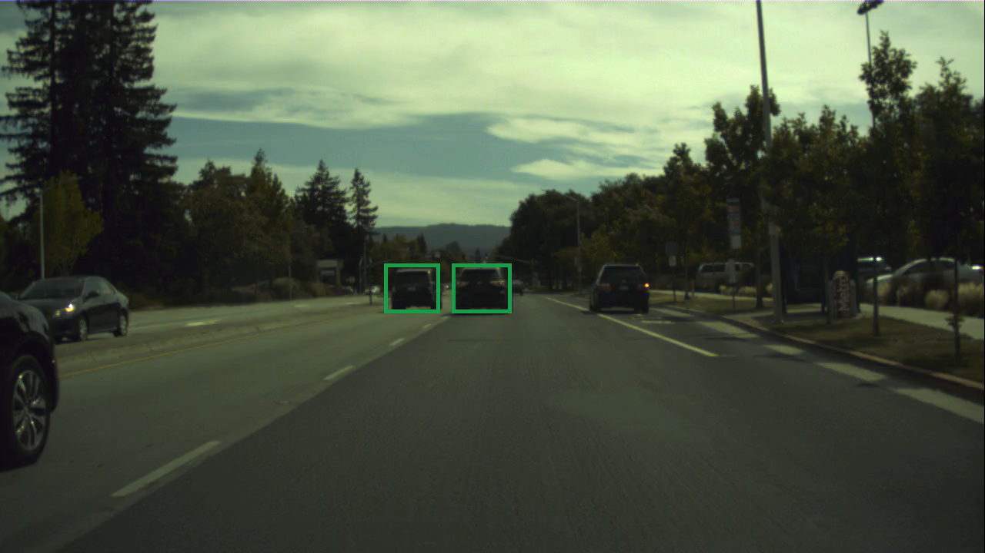
Bosche Dataset We Labeled

Slide 10
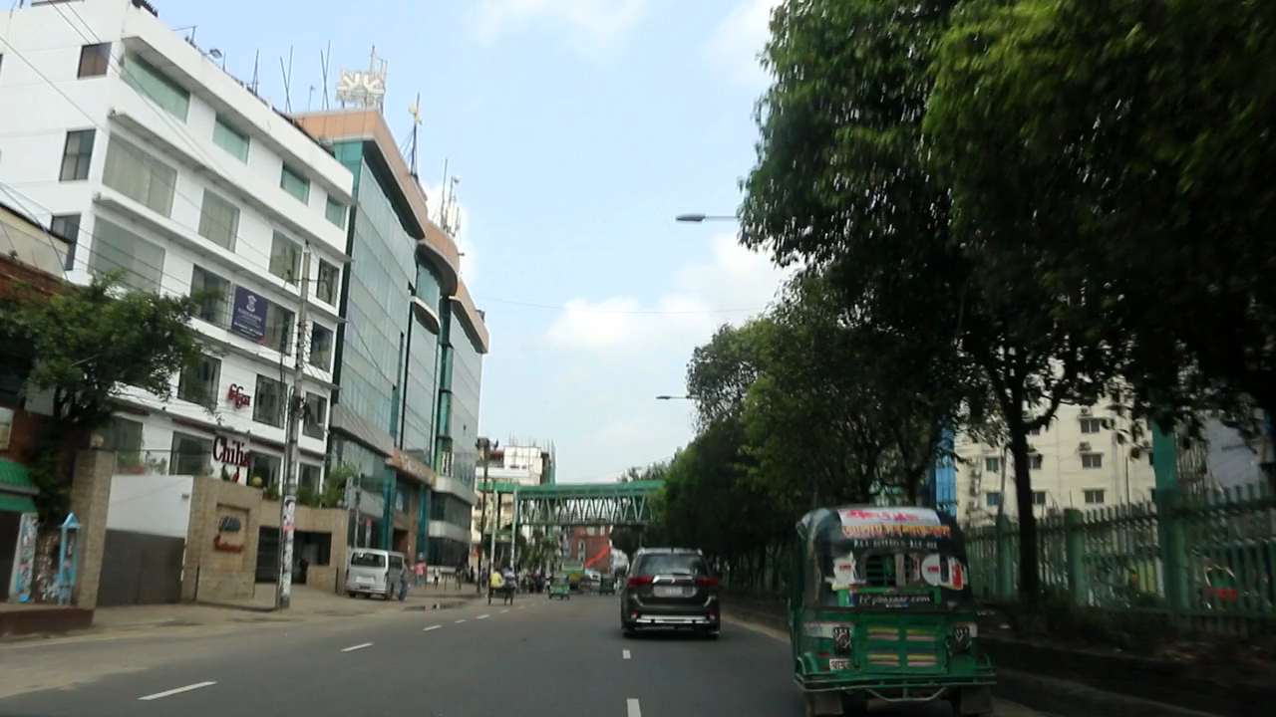
Own Dataset We Collected

Slide 11
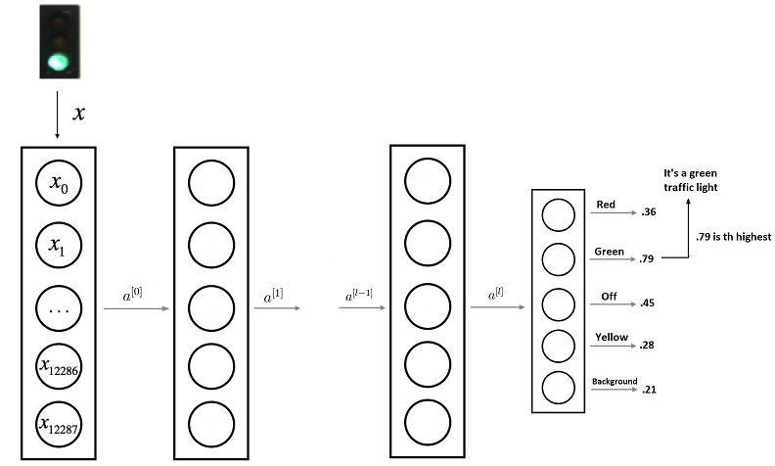
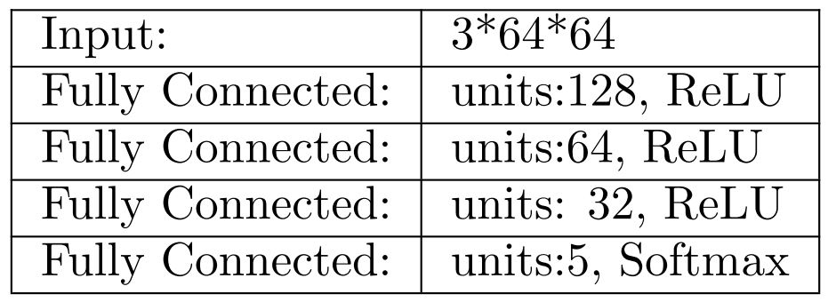
Our DNN Model
We trained our model for 71 minutes

Slide 12
Evaluation of Result
Classification Result:
Classification Speed:
Existing result
Our result
Validation set accuracy | 99% | 95%
Test set accuracy | 95.1% | 95%
Existing speed
Our speed
Per Image | .0018 milliseconds | .8 milliseconds

Slide 13
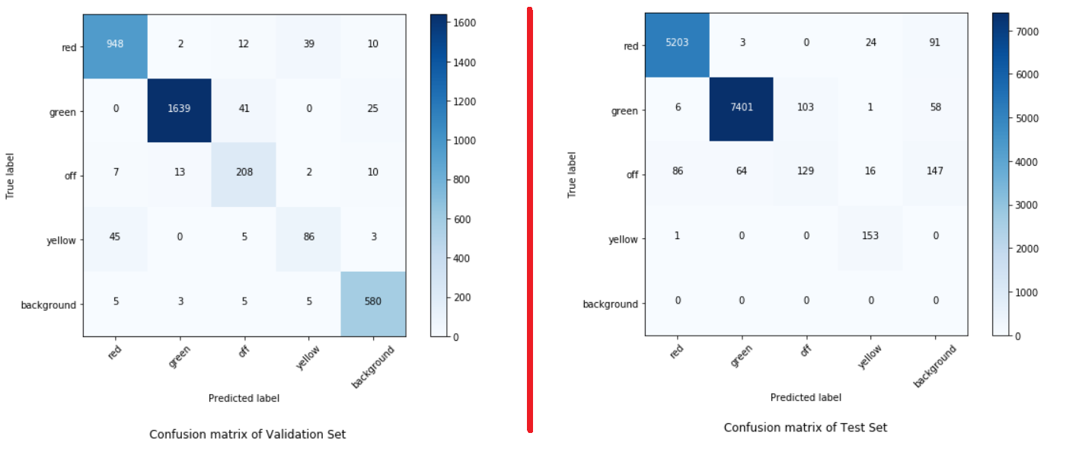
Evaluation of Result (CONTD.)
Classification Result:

Slide 14
Our Future Plan
Convert our classification model from Deep Neural Network to Convolutional Neural Network.
Implement the detection part of traffic light.
Label our own data set for car brake light.
Implement detection and classification over our own dataset of car brake light and the existing Bosche Dataset.

Slide 15
Thank You
Any Question ?

